Slide 1
http://www.vidyanidhi.com/
ketkiacharya.net@gmail.com
Ketki Acharya
From: SM VITA ATC of CDAC
9769201036
ketkiacharya.net@gmail.com

Slide 2
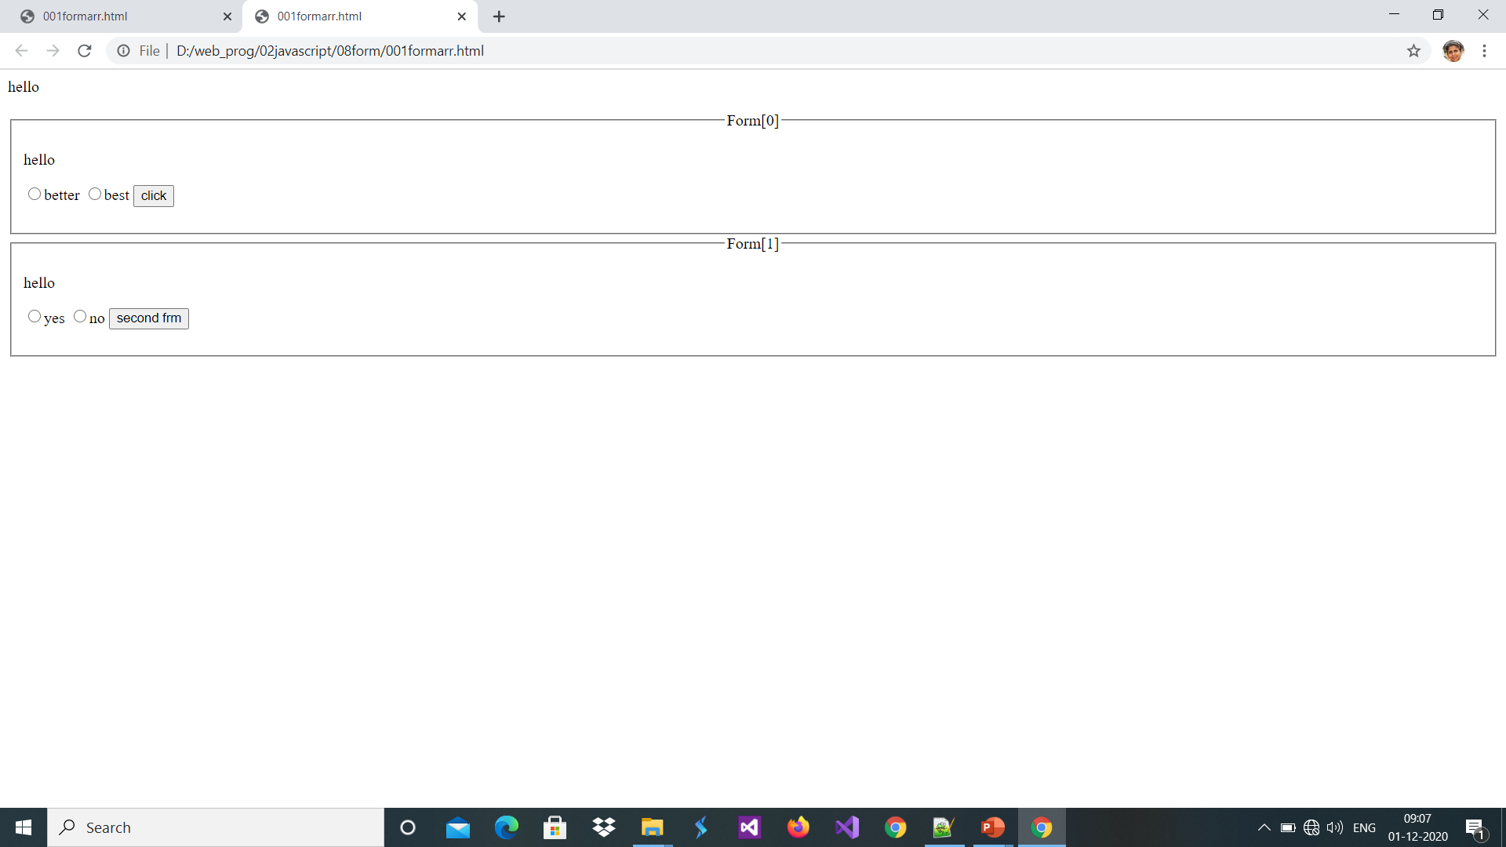
Entire page is array of data
Elements[0] radiobutton
Forms-[0]
Elements[2]
button
Elements[1] radiobutton
Forms-[1]
Elements[0] radiobutton
Elements[1] radiobutton
Elements[2]
button
All data in page are in form of Array

Slide 3
<html><head><script>
function call()
{ var v=document.forms[0].elements.length
alert(document.forms.length);
alert(v)
for(let i=0;i<v;i++)
document.getElementById("n").innerHTML+=(document.forms[0].elements[i].value)
}
function call2()
{ alert ("hi"); }
</script></head><body>
<p id="n">hello</p>
<fieldset >
<legend align="center">Forms[0]</legend>
<form>
<p id="n">hello</p>
<input type="radio" name="rd" value="better"/>better
<input type="radio" name="rd" value="best"/>best
<input type="button" value="click" onclick="call(),call2()">
</form>
</fieldset>
<fieldset>
<legend align="center">Forms[1]</legend>
<form legend="Form[1]">
<p id="mm">hello</p>
<input type="radio" name="dd" value="yes"/>yes
<input type="radio" name="dd" value="no"/>no
<input type="button" value="second frm" onclick="call(),call2()">
</form>
</fieldset> </body></html>

Slide 4
Programming the Web DHTML
The DHTML Document Object Model (DOM)
window
event
navigator
history
document
location
screen
frames
all
location
children
forms
selection
body
links
text
radio
button
textarea
select
password
checkbox
submit
option
file
reset

Slide 5
Java script DOM
<html><head><script>
function call()
{
var a=document.frm.t1;
var b=document.frm.t2
b.value=a.value;
}
</script></head><body>
<form name="frm" action="a.html" onsubmit="return true">
name<input name="t1"/>
<input type="button" value="copy" onclick="call()"/>
copied name<input name="t2"/>
<input type="submit"/>
</form></body> </html>
How to access text box with name t1?
Observe form also has name so we will be using
let obj=window. document.frm.t1 with this line you will get textbox object.
To get value of text box just use obj. value

Slide 6
How to pass form in a function :this.form
<html><head>
<script>
function call(a)
{ v=a.length
alert(a)
alert(v)
let data=“”;
pobj=document.getElementById("pp");
for(i=0;i<v;i++)
{ data=data+a.elements[i].value;
}
pobj.innerHTML=data;
}
</script></head><body>
<p id="pp">
<form>
<input type="radio" name="rd" value="good">good
<input type="radio" name="rd" value="better">better
<input type="radio" name="rd" value="best">best
<input type="button" value="click" onclick="call(this.form)">
</form></body></html>
`
form
a
this.form

Slide 7
How to read value of radio button and checked keyword
<html><head><script>
function readradio()
{
var l=document.frm.rd.length
let pobj=document.getElementById("pp")
if(document.frm.rd[0].checked)
pobj.innerHTML=document.frm.rd[0].value
else
pobj.innerHTML=document.frm.rd[1].value
}
function cc()
{
document.frm.rd[0].checked=true;
}
</script></head>
<body>
<p id="pp"></p>
<form name="frm">
<input type="radio" name="rd" value="yes" />yes
<input type="radio" name="rd" value="no" checked/>no
<input type="button" value="read" onclick="readradio()">
<input type="button" value="chk" onclick="cc()">
</form></body></html>
pobj
<p id="pp"> </p>
document.frm.rd[0].value
<input type="radio" name="rd" value="yes" />yes
if(document.frm.rd[0].checked)
Checked keyword return Boolean value
If radio button is checked then return true else false

Slide 8
new Document
new Form
0 | 1
frm
document
new InputElemnt
checked
return true

Slide 9
How to read value of check box
<html><head><script>
function readchk()
{
var sldata="";
if(document.frm.a.checked)
sldata+=document.frm.a.value
if(document.frm.b.checked)
sldata+=document.frm.b.value
if(document.frm.c.checked)
sldata+=document.frm.c.value
document.getElementById("dd").innerHTML=sldata;
}
</script></head><body>
<form name="frm">
<input type="checkbox" name="a" value="dance"/>dance
<input type="checkbox" name="b" value="music"/>music
<input type="checkbox" name="c" value="sports"/>sports
<div id="dd"></div>
<input type="button" value="read" onclick="readchk()">
</form></body></html>
if(document.frm.a.checked)
Checked keyword return Boolean value
If checkbox is checked then return true else false

Slide 10
How to read selected value of dropdown
<html><head><script>
function readradio()
{
var l=document.frm.sl.length
for(i=0;i<l;i++)
{ if(document.frm.sl[i].selected)
document.frm.t.value=(document.frm.sl[i].value)
}
let pobj=document.getElementById("pp");
pobj.innerHTML=document.frm.sl.selectedIndex
let index=document.frm.sl.selectedIndex;
pobj.innerHTML+=(document.frm.sl[index].text)
}
</script>
</head><body><p id="pp"></p>
<form name="frm">
<select name="sl“ onchange="readradio()" >
<option value="0">dance</option>
<option value="1">music</option>
<option value="2">sports</option>
</select>
<input disabled name="t"/>
<input type="button" value="read" onclick="readradio()">
</form>
</body></html>
if(document.frm.sl[0]. selected)
Checked keyword return Boolean value
If option is selected then return true else false
selectedIndex
This keyword will return the index of selected option
text
<option value="0">dance</option>
value

Slide 11
Create a dynamic form
<html><script>
function call()
{
var f=document.createElement('form’)
f.name='frm'
var t= document.createElement('input')
t.type='text'
t.maxlength=5;
t.name="t1"
r1= document.createElement('input')
l1=document.createElement('label')
r2= document.createElement('input')
l2=document.createElement('label')
r1.type="radio"
r2.type="radio"
r1.name="nm"
r2.name="nm"
newText1=document.createTextNode("yes");
newText2=document.createTextNode("No");
l1.appendChild(newText1);
l2.appendChild(newText2);
var s= document.createElement('select') ;
var o=document.createElement('option')
var o1=document.createElement('option')
o.innerHTML="India";
o1.innerHTML="USA";
s.appendChild(o);
s.appendChild(o1);
f.appendChild(t);
f.appendChild(r1);
f.appendChild(l1);
f.appendChild(r2);
f.appendChild(l2);
f.appendChild(s);
//f.appendChild(c1);
document.getElementById('dd').appendChild(f);
}
</script>
<body>
<input type="button" onclick="call()"/>
<div id='dd'> </div>
</body>
<form name="frm">
<input type="text" name="t1">
<input type="radio" name="nm">
<label>yes</label>
<input type="radio" name="nm">
<label>No</label>
<select>
<option>India</option>
<option>USA</option>
</select>
</form>

Slide 12
Form level event ➔ onsubmit="return check()"
<html><head>
<style>.err{color:red}</style>
<script>
function check()
{
var tobj=document.frm.nm //textbox
data=tobj.value //value of textbox
var len=data.length
let sobj=document.getElementById("ter");
//required
if(len==0)
{
sobj.innerHTML= "password can not be blank"
document.frm.nm.focus()
return false
}
else if(len<8||len>16)
{
sobj.innerHTML="minimum 8 character required and can not exceed 15"
return false
}
else
sobj.innerHTML=""
}
function setcur()
{//autofocus
var tobj=document.frm.nm
tobj.focus()
}
</script></head>
<body onLoad="setcur()">
<form name="frm" action="blur.html"
onsubmit="return check()">
<label>Password</label>
<input type="text" name="nm" >
<span id="ter" class="err"></span>
<input type="submit" value="submit" >
</form></body></html>
In above example check function return false if password is blank or password is < 8 character or >16 character.
It also print appropriate message in span tag.
By default onsubmit event has return value true and it is form level event , get fires when you click on submit button
So if function not returning any value for valid data then it will read as true and control will go to blur.html page

Slide 13
How to make Dum button intelligent: Dynamically submitting form
<html>
<style>.err{color:red}</style>
<script>
function check()
{ bool=true;
var data=document.frm.nm.value
var len=data.length
let sobj=document.getElementById("ter");
//required
if(len==0)
{
sobj.innerHTML= "password can not be blank"
document.frm.nm.focus()
bool= false
return bool;
}
else if(len<8||len>16)
{
sobj.innerHTML= "minimum 8 character required and can not exceed 15"
bool= false
return bool;
}
else
sobj.innerHTML=""
if(bool==true)
document.frm.submit();//dynamically firing event
}
function setcur()
{//autofocus
document.frm.nm.focus()
}
</script>
<body onLoad="setcur()">
<form name="frm" action="blur.html">
<label>Password</label>
<input type="text" name="nm" ><span id="ter" class="err"></span>
<input type="button" value="dum" onclick="check()">
</form>
</body>
</html>

Slide 14
Task
Q1. Create three textbox and two radio button [+ ,*] On click of radio button result of operation should be displayed in third text box give basic validation.
Q2. create 3 check box displaying book name and price, as per selection of user, display total amount of book purchased in a disabled text box.
Q3. create a dropdown list displaying state on change of it display selected state in a textbox.
Q4. create 3 textbox and a dropdown list displaying mathematical operation. On click of button it should display result in 3rd text box
Q5. Using JavaScript Create banner, include 4 images. Images should rotate after time gap of 1 second.
Q6. Create a web page for entering all personal details Information should containName, Date of Birth (use select drop down list), Gender, Address, Ps. No. , batch No. and Date of Joining (use select drop down list) Validate this form
Q7. Display digital clock
Refer folder student data for more examples and logic
{“Gujrat”:”Ahamdabad”
}

Slide 15
Answer Q1.
<html> <head>
<script>
function dotask(operation)
{
let n1=document.getElementById("n1")
let n2=document.getElementById("n2")
let n3=document.getElementById("n3")
//+before string convert string to number
if(operation=="+")
{ n3.value= +n1.value + +n2.value
}
else if(operation=="*")
n3.value= n1.value*n2.value
}
function validate(a,sid)
{ alert("hh")
//let n1=document.getElementById("n1")
let s1=document.getElementById(sid)
if(a.value.length==0||a.value=="")
s1.innerHTML="Text field can not be blank"
if(isNaN(a.value))
s1.innerHTML="only number value allowed"
}
</script></head>
<body>
<form>
<input type=“text" id="n1" onchange="validate(this,'err1')"/><span id="err1"></span>
<input type=“text" id="n2" onchange="validate(this,'err2')"/><span id="err2"></span>
<input type="radio" name="r1" value="+" onchange="dotask(this.value)"/>+
<input type="radio" name="r1" value="*" onchange="dotask(this.value)"/>*
<input type="number" id="n3" disabled/>
</form>
</body>
</html>

Slide 16
isNaN() return boolean
<script>
a=isNaN("56 ket");
document.write("data is not a no "+a);//true
b=isNaN(5)
document.write("<br> 5 is not a no. "+b);//false
c=isNaN("5")
document.write("5 takenn as string is not a no "+c)//false
b=isNaN(5+5)//false
</script>
isNaN(“5”)==check entered data is number or not?
Even if number is in “” it will call valueOf()

Slide 17
Answer Q2
<html><head><script>
function dosum()
{
var sldata=0;
if(document.frm.a.checked)
sldata+= +document.frm.a.value
if(document.frm.b.checked)
sldata+= +document.frm.b.value
if(document.frm.c.checked)
sldata+= +document.frm.c.value
document.getElementById("dd").innerHTML=sldata;
}
</script></head><body>
<form name="frm">
<input type="checkbox" name="a" value="250"/>C 250/-
<input type="checkbox" name="b" value="750"/>c# 750/-
<input type="checkbox" name="c" value="550"/>JavaScript 550/-
<div id="dd"></div>
<input type="button" value="read" onclick="dosum()">
</form></body></html>

Slide 18
Name:➔minimum 5 max 15 chaeacter
Password:➔ [char number and symbol]min 8 max 15
Email:➔@ after . Minimum 2 or max 3 character
Address:➔min 10 max 35
DOB:➔ calannder ➔18 and max 80
Mobile:➔10 digit
Education➔ drop down
Gender: Male Female radio
Submit
Give basic validation

